Slide 1
7-3 Knock-out Barrier Option
學生： 潘政宏

Slide 2








障礙選擇權即是選擇權標的物價格上(下)方設有障礙
價格，當價格觸碰到障礙價格，則合約失效(生效)，
即knock-out (knock-in) option。
一般標準障礙選擇權可分為八種：
 | Out option | In option
Up option ( B > S(0) )
Down option ( B < S(0) )

Slide 3
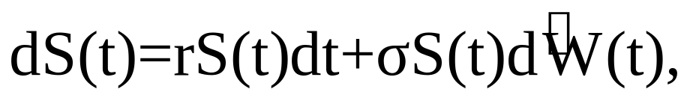
7.3.1 Up-and-Out Call
Our underlying risky asset is geometric
Brownian motion:
Consider a European call,
T：expiring time
K：strike price
B：up-and out barrier

Slide 4
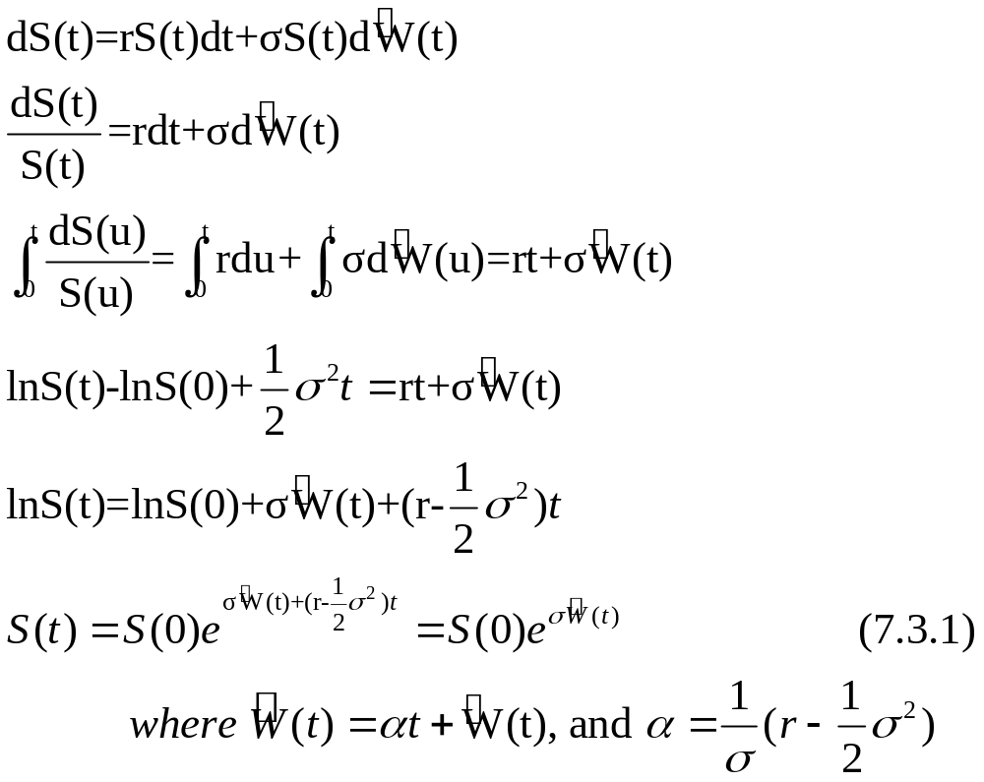
Ito formula

Slide 5
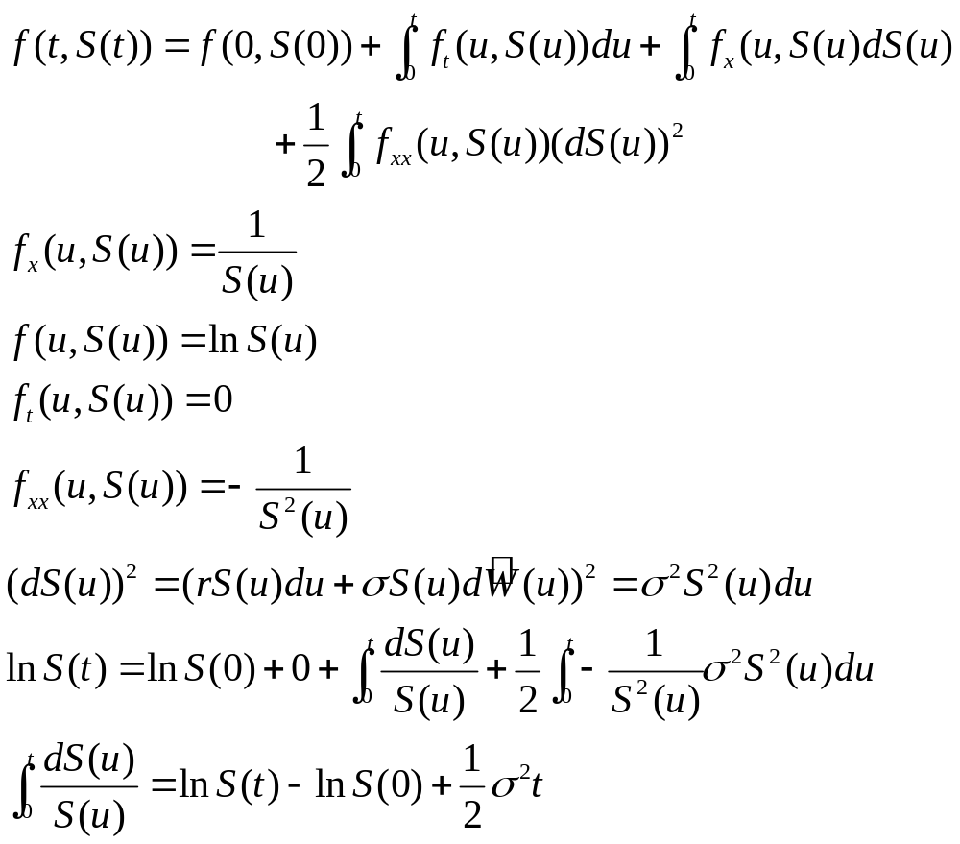
Ito formula
Back

Slide 6
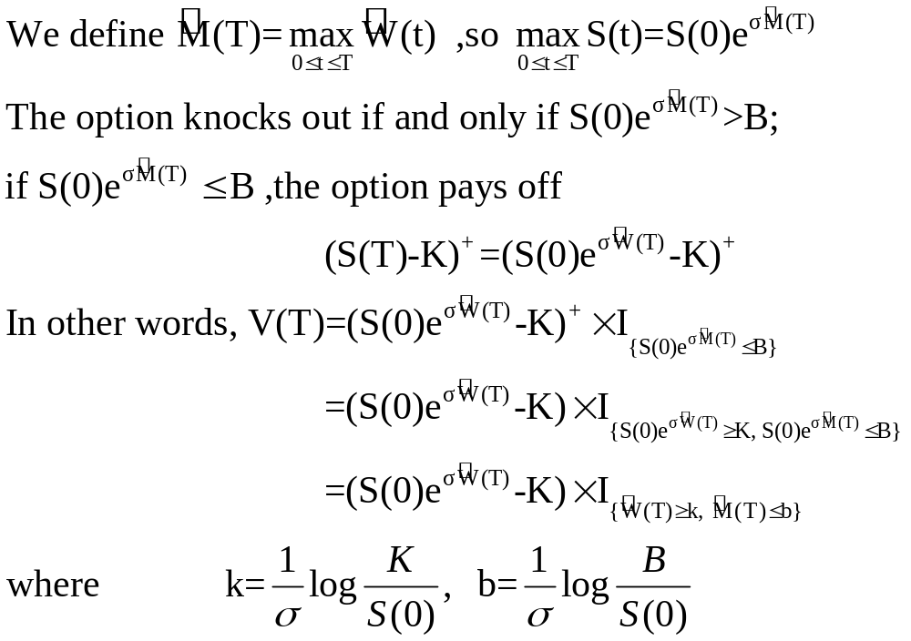

Slide 7
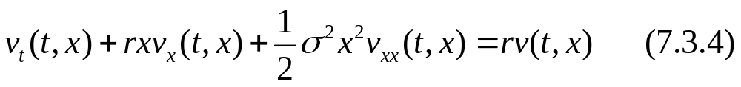
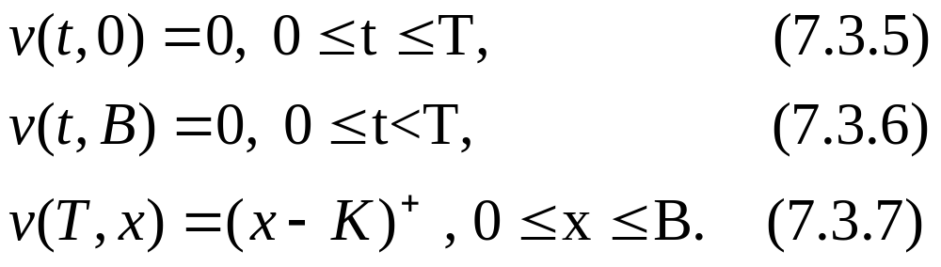
7.3.2 Black-Scholes-Merton Equation
Theorem 7.3.1
Let v(t,x) denote the price at time t of the up-and-out
call under the assumption that the call has not knocked
out prior to time t and S(t)=x. Then v(t,x) satisfies the
Black-Scholes-Merton partial differential equation:
In the rectangle {(t,x);0≦t＜T, 0≦x≦B} and satisfies
The boundary conditions

Slide 8
Derive the PDE (7.3.4):
(1)Find the martingale,
(2)Take the differential
(3)Set the dt term equal to zero.
Begin with an initial asset price S(0)∈(0,B).
We define the option payoff V(T) by (7.3.2).
By the risk-neutral pricing formula:
And
Is a martingale.

Slide 9
We would like to use the Markov property to say that
V(t)=v(t,S(t)) ,where v(t,S(t)) is the function in Theorem
7.3.1. However this equation does not hold for all
Values of t along all paths.
V(t) | V(t ,S(t))
If the underlying asset price rises above the barrier B and then returns below the barrier by time t , then V(t)=0 | v( t, S(t))is strictly positive for all value of 0≦t≦T and 0<x<B
Path-dependent and remember that option has knock-out | Not path-dependence, when S(t)<B give the price under the assumption that it has not knock-out.

Slide 10
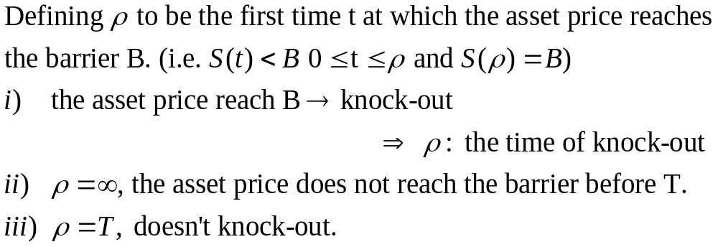
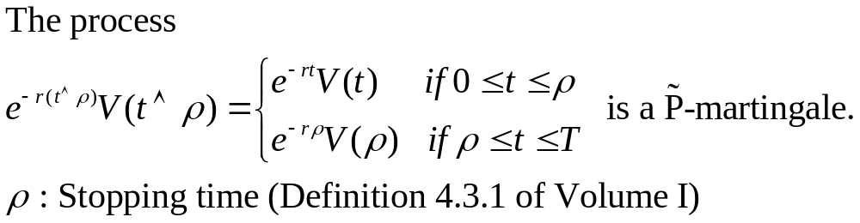

Slide 11
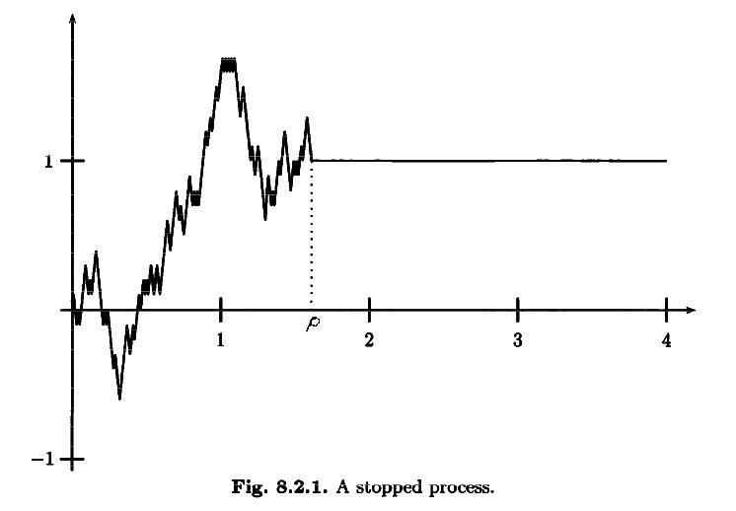
Theorem 8.2.4(Theorem 4.3.2 of Volume I)
A martingale stopped at a stopping time is still a
martingale.

Slide 12
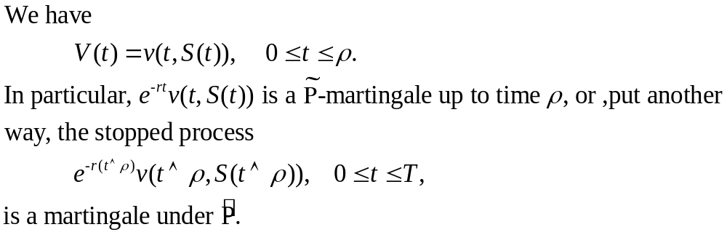
Lemma 7.3.2

Slide 13
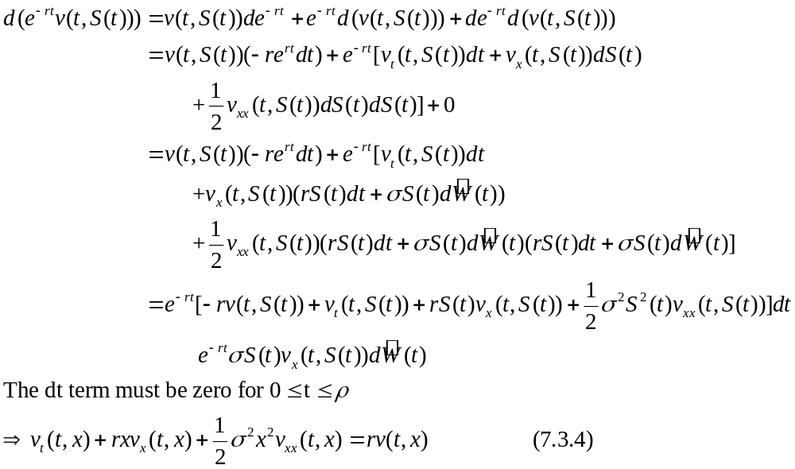
Proof of Theorem 7.3.1

Slide 14
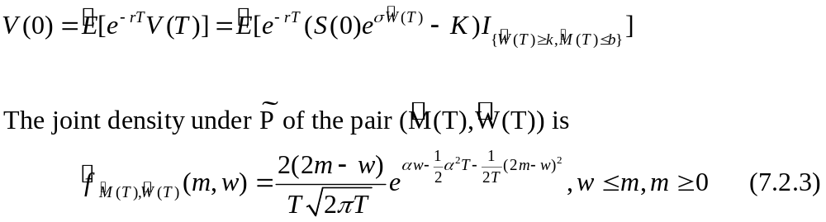
7.3.3 Computation of the Price of the
Up- and-Out Call

Slide 15
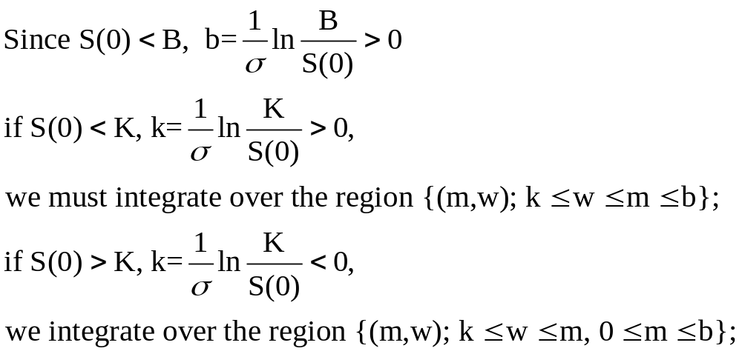
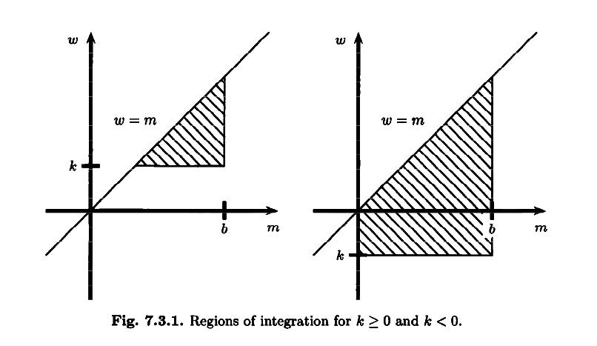

Slide 16
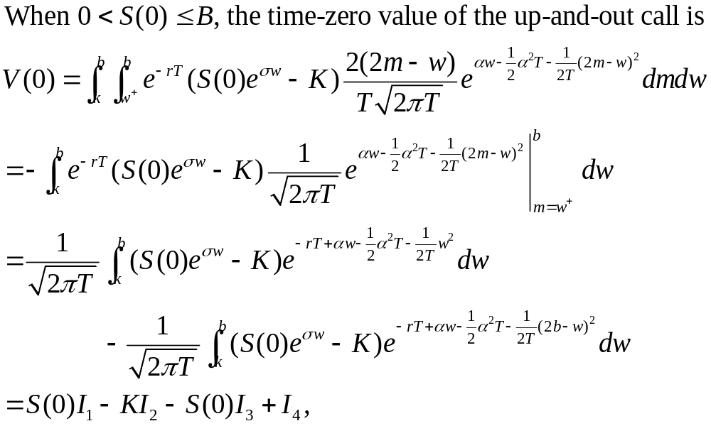

Slide 17
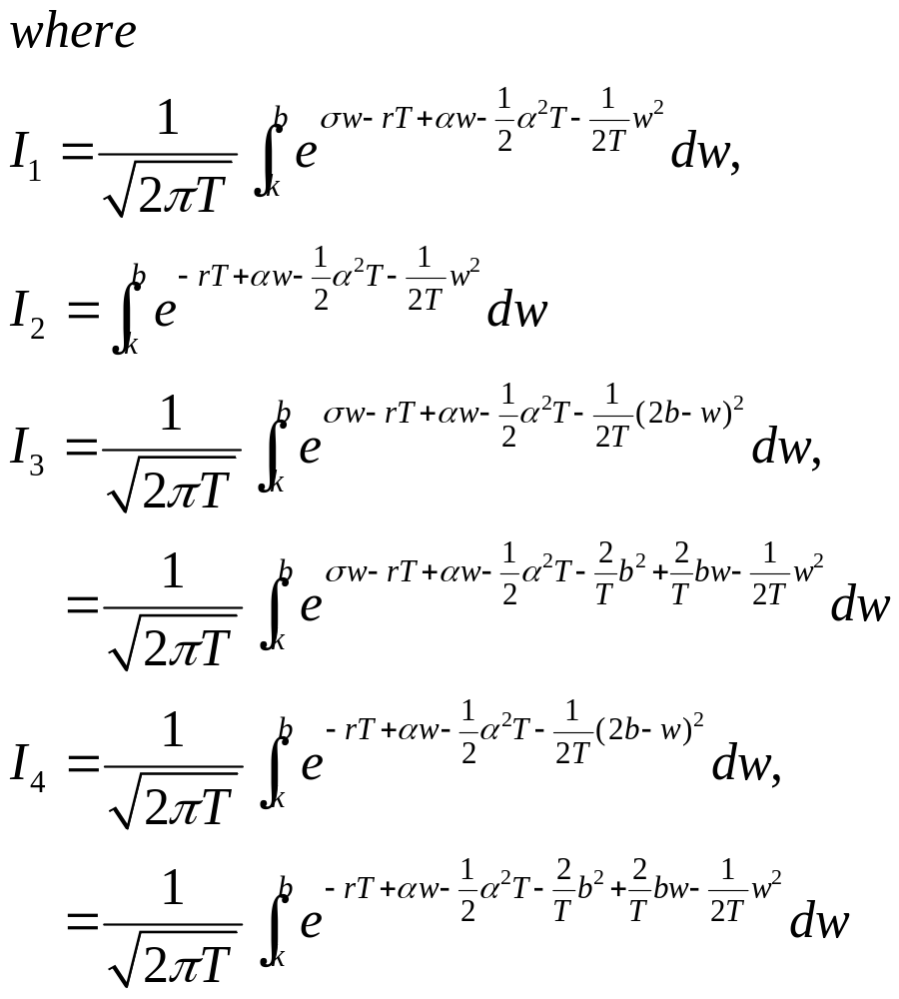

Slide 18
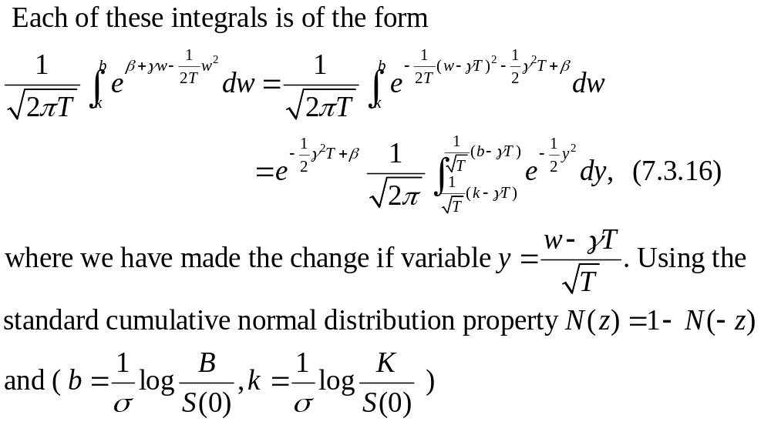

Slide 19
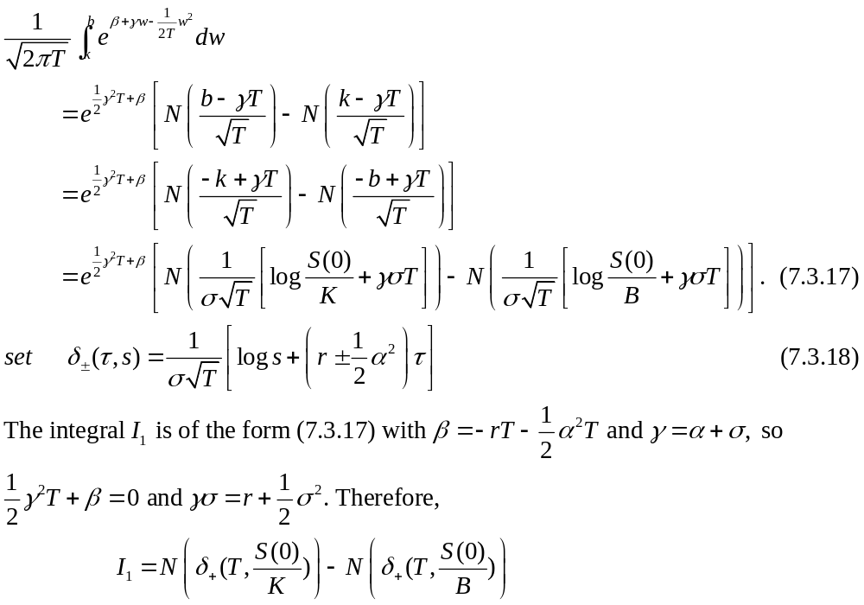

Slide 20
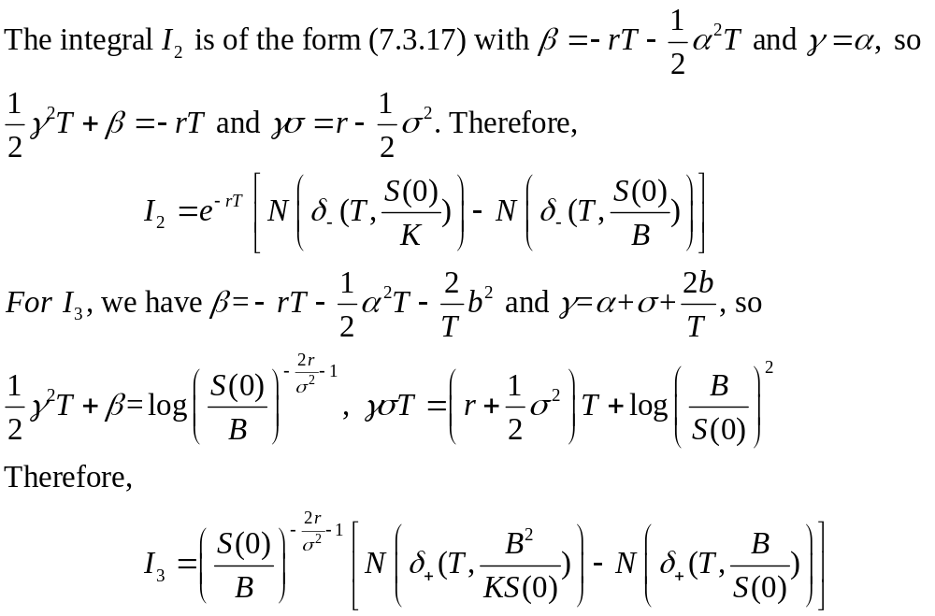

Slide 21
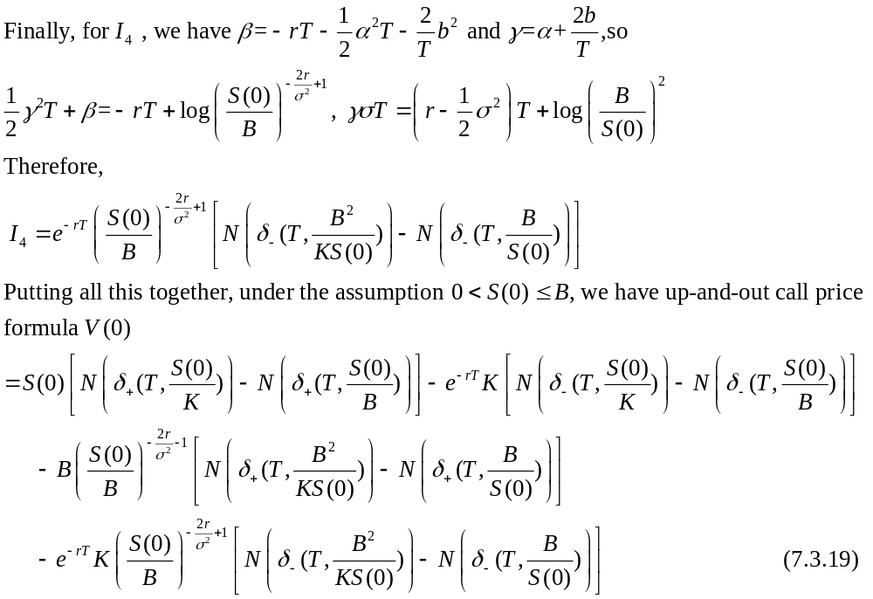

Slide 22
